Slide 1
CAPSTONE PROJECT
Coronavirus Tweet Sentiment Analysis
PRESENTED BY
NAME: NITHYA M
COLLEGE: MANGAYARKARASI COLLEGE OF ENGINEERING
DEPT: EEE

Slide 2
PROBLEM STATEMENT
This challenge asks you to build a classification model to predict the sentiment of COVID-19 tweets . The tweets have been pulled from Twitter and manual tagging has been done then. The names and usernames have been given codes to avoid any privacy concerns.

Slide 3

OBJECTIVE
Our objective is to build a classification model to predict the sentiment of COVID-19 tweets . The tweets have been pulled from Twitter and manual tagging has been done then. The names and usernames have been given codes to avoid any privacy concerns.

Slide 4
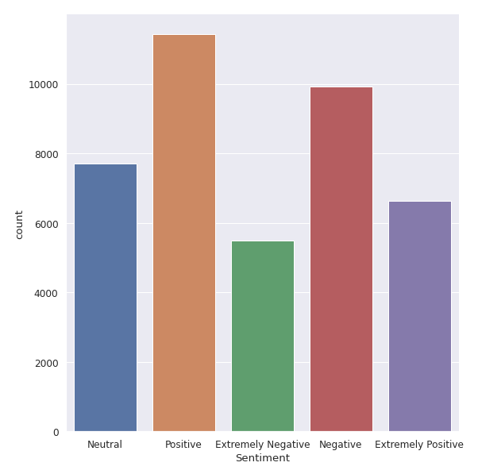
EXPLORATORY DATA ANALYSIS
The original dataset has 6 columns and 41157 rows.
There are five types of sentiments- Extremely Negative, Negative, Neutral, Positive and Extremely Positive.
All tweets data collected from the months of March and April 2020. Bar plot shows us the number of unique values in each column.

Slide 5
PROPOSED SOLUTION

